Slide 1

Predictive Modelling of University Dropouts
Team 2 – The Cabbages
Project 4 Data Visualisation Bootcamp
Yasar, Tooba, Musab, Ifa & Zeeshan

Slide 2


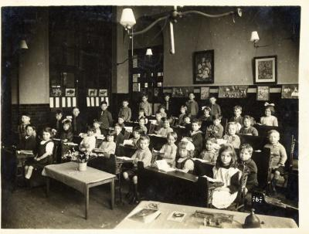
History of education
Our dataset focuses on higher education and the factors that influence student outcomes, specifically dropouts and completions.
Notes:
Universities have come a long way since their early days in the medieval period. They started as centers of religious studies and have since transformed into multidisciplinary hubs that foster science, arts, and various professional studies.
In our globalized world, we've observed that universities grapple with ensuring student retention and success. Factors such as socio-economic background, academic performance, and personal circumstances play a pivotal role – elements that we've aimed to analyze in our dataset.

Slide 3

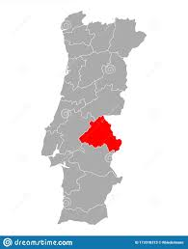
Dataset
Portuguese data from the Polytechincal Institute of Portalegre.
Data from 2008/9 - 2018/19 academic years
17 different undergraduate degrees
4424 records
35 attributes (columns)
Notes:
e.g agronomy, design, education, nursing, journalism, management, social service, and technologies
our dataset sources Kaggle and used csv file.
The data has been compiled from data held by the Portugese equivalent of UCAS:

Slide 4
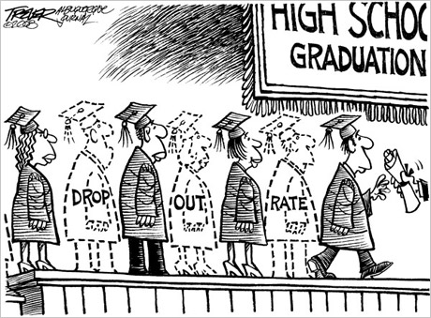
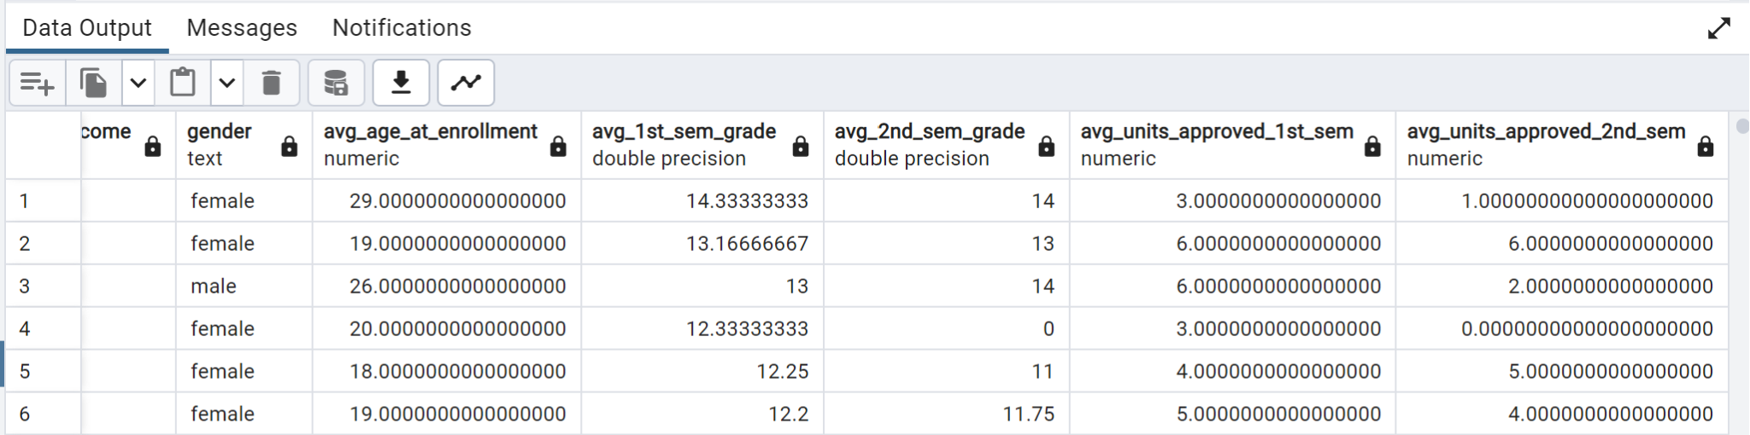
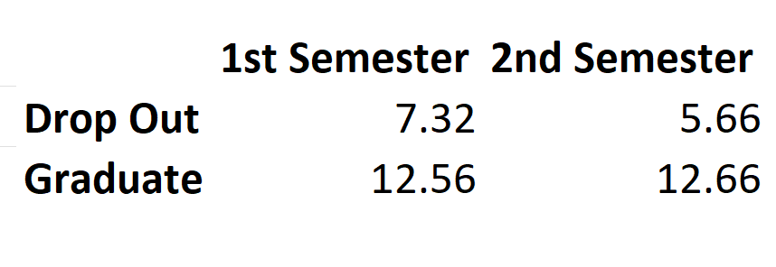
SQL Queries Overall Academic Performance by Outcome
Notes:
To comprehend our dataset and explore potential insights, we began by creating tables and importing our data into an SQL database. I then executed a query to calculate the average performance metrics based on outcomes and gender.
For "DROPOUTS," we observed an average grade of 7.32 in the 1st semester and 5.66 in the 2nd semester. In contrast, "GRADUATES," our accomplished students, attained an average grade of 12.56 in the 1st semester and an admirable 12.66 in the 2nd semester..
What's clear from these numbers is that academic performance, especially as indicated by the semester grades, is a strong predictor of student outcomes. Those with lower grades are more likely to drop out compared to their counterparts.

Slide 5

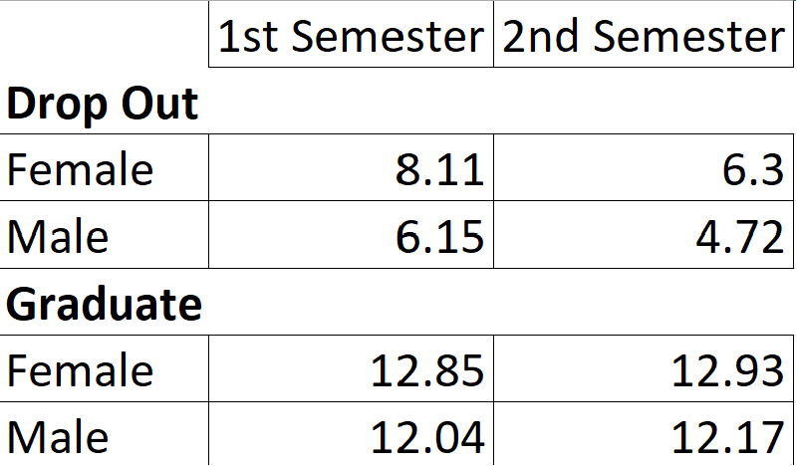
Analysis by Gender
Notes:
we then did a bit of analysis into the influence of gender on academic performance:
what we noticed is that females' grades decreased from 8.11 to 6.30 for dropouts and increased slightly from 12.85 to 12.93 for graduates, while males' grades dropped from 6.15 to 4.72 for dropouts and rose from 12.04 to 12.17 for graduates between the 1st and 2nd semesters.
the data suggests that across all outcomes, females tend to have higher grades than males. This indicates that gender might have a significant role in academic performance and outcomes.
to conclude, based on our findings, we recommend we should consider proactive measures for students with grades below a certain threshold, offering them additional academic support. to gain more insights into this data im passing it over to my colleague who has explored applying machine learning models which will help in better predicting student outcomes.

Slide 6



Data Cleaning and Processing
REMOVED THE ENROLLED ROWS (APPROXIMATELY 700 ROWS)
REMOVED THE APPLICATION MODE AND ORDER. THIS INFORMATION WAS ADMINISTRATIVE AND COULD POTENTIALLY CONFUSE OUR MODELLING ANALYSIS.
IMPORTED THE DATA INTO SQL AND USED SQL LITE VIEWER.
Notes:
To clean and processed the data :
REMOVED THE ENROLLED ROWS (APPROXIMATELY 700 ROWS)
REMOVED THE APPLICATION MODE AND ORDER. THIS INFORMATION WAS ADMINISTRATIVE AND COULD POTENTIALLY CONFUSE OUR MODELLING ANALYSIS.
IMPORTED THE DATA INTO SQL AND USED SQL LITE VIEWER.
Changed the categorical target data labels of graduate vs dropout into binary 0 vs 1 in order to for our model to work.

Slide 7
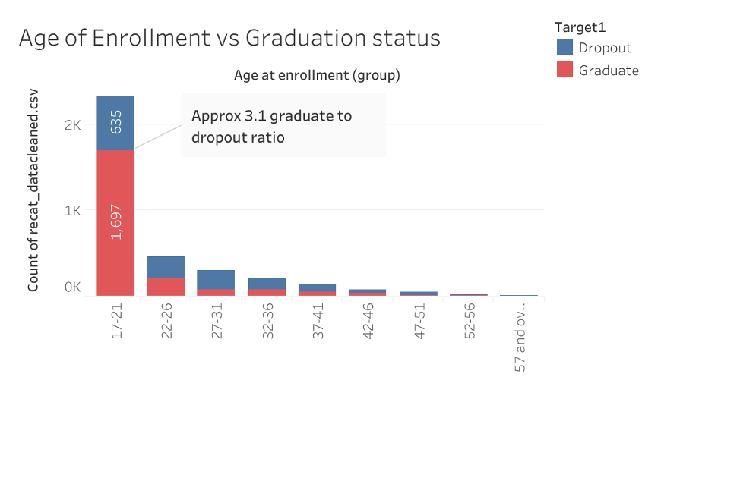
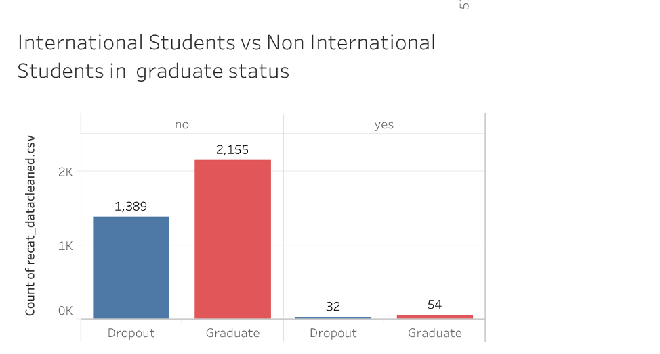
Notes:
In order to use the data in tableau visualisations the the numerical data needed to be converted to the categorical data they represented.
Comparing age of enrollment vs graduation status; In all the age groups graduate numbers are higher than the dropout numbers or at least equal.
There is a large proportion of students in in aged 17-21 with a graduate: dropout ratio of approx 3:1.
This indicates that age group might have a significant role in academic performance and outcomes.
Comparing student national status vs graduate status: For both international and non international students number of graduates is significantly higher specially that for non international students.

Slide 8
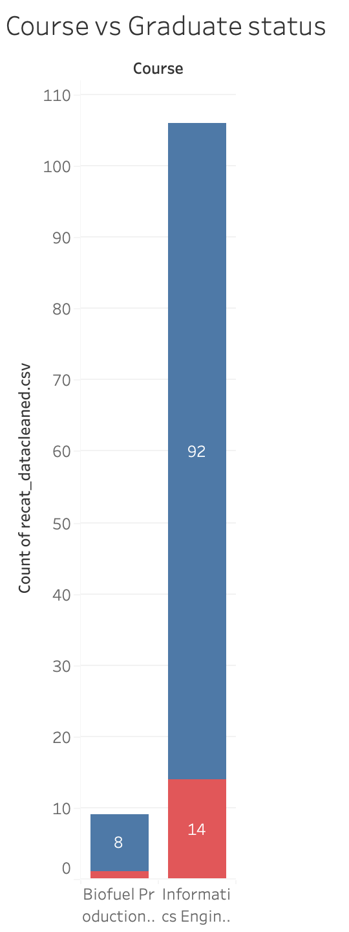
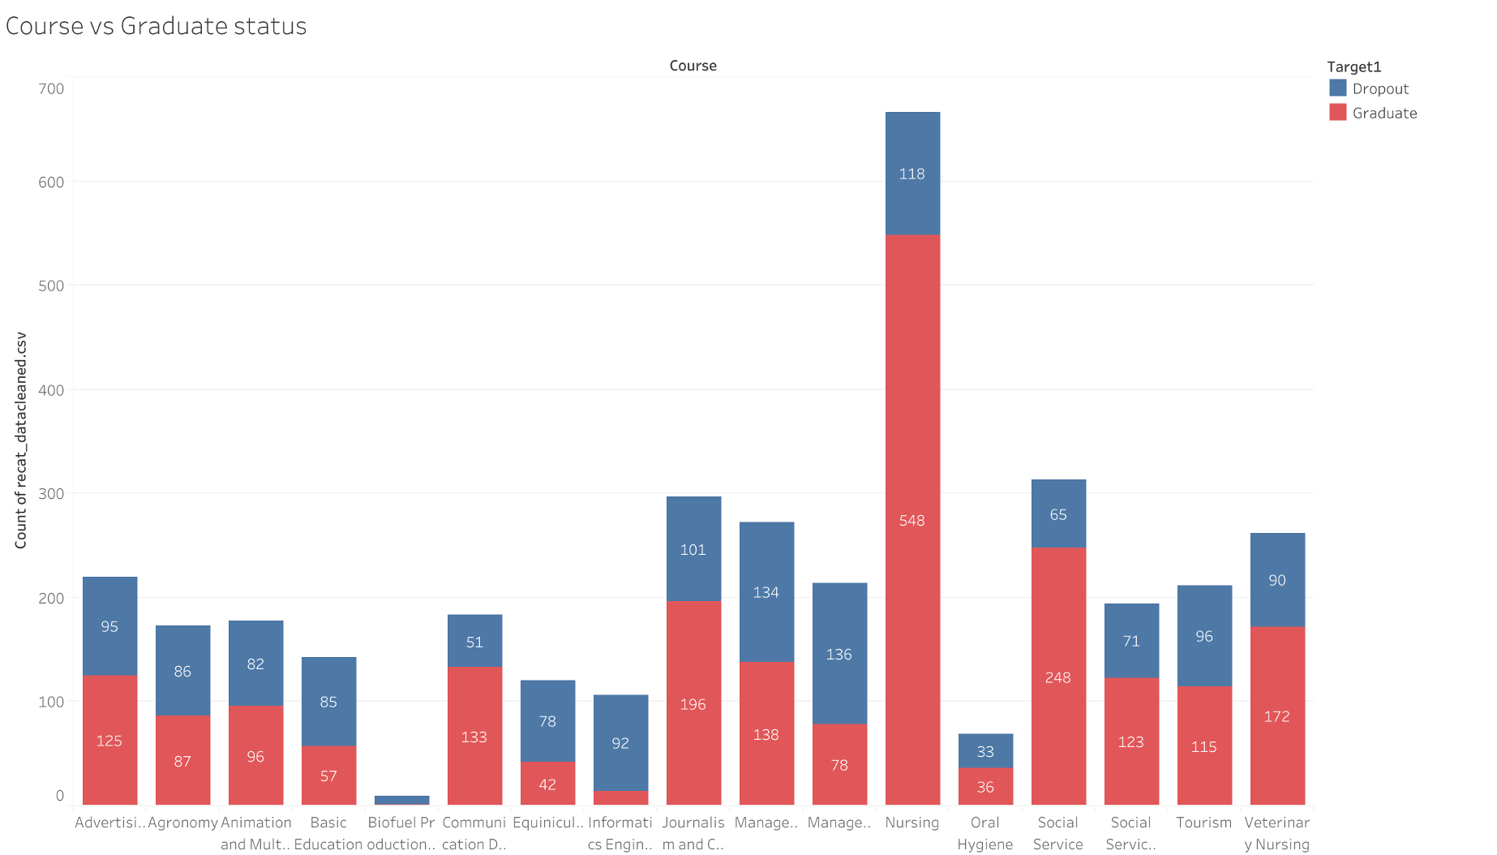
Notes:
If we break it down by the course over all across all subjects graduate numbers are significantly higher than dropout numbers, apart from the Biofuel production and Informatics engineering courses which a significantly high number of dropouts compared to graduates.

Slide 9
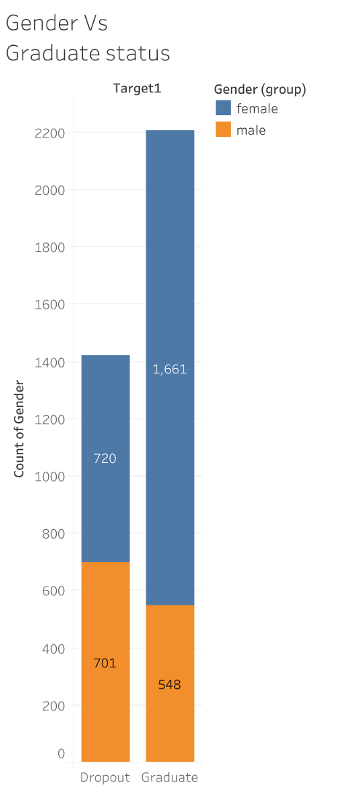
Notes:
The data suggests gender may have a significant effect on academic performance as females tend to have a higher grades than males and the majority of graduates were female vs male with a 3:1 ratio This indicates that gender might have a significant role in academic performance and outcomes.

Slide 10
Machine Learning
Exploratory data analysis
Python 3.7.11
Pandas library version 1.4.3,
Scikit-learn library version 1.1.1,
Notes:
The experiments carried out using the statistical program Python 3. The experiment was set up as follows.
The dataset was divided into training, testing, and validation sets.
To validate the system, 20% of the data was randomly chosen and kept aside to prove the performance of the final classifier. The remaining 80% of the data was split according to the semester in which the data was collected. Finally, we trained the classifier from the data of all semesters except one, which was used as a testing set.

Slide 11
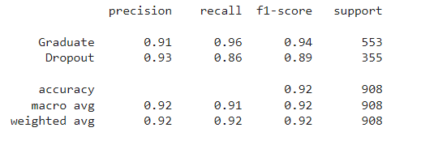
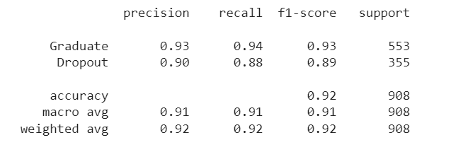
Supervised Learning Model
Classification Report
Logistical regression model.
Target variable: “dropout vs graduate”
Using 32 attributes.
Initial train/test split: 75%/25%
Overall accuracy 92%
Dropout Recall 86%
Notes:
A logistical regression model used to determine the target variable of “dropout vs graduate”, using the 32 attributes
We were a achieve n overall accuracy score of 92%

Slide 12
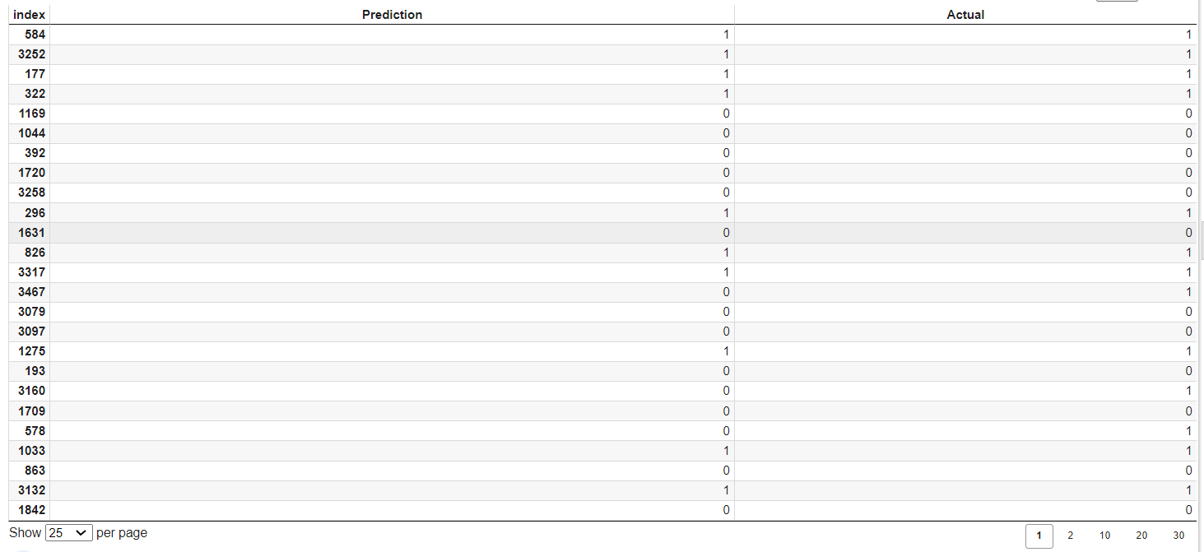
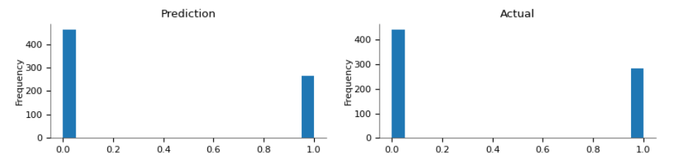
Models predictions vs actual

Slide 13

Can we improve the Dropout recall?

Slide 14
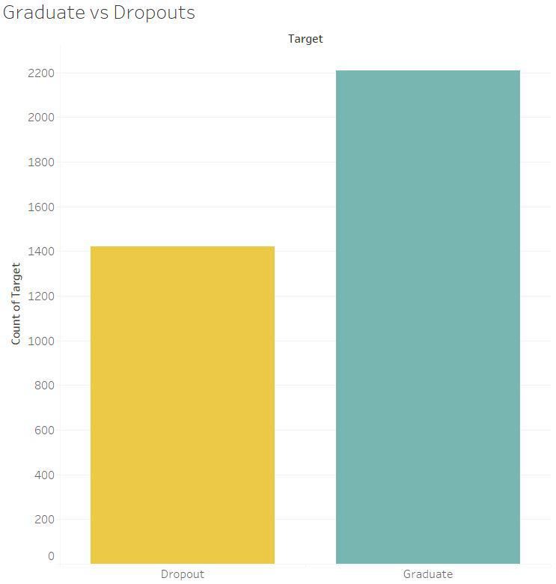
Original data was imbalanced.
Target data skewed towards graduate ( 3:2 ratio)
Notes:
Approx 2200 graduates, to 1400 dropouts

Slide 15
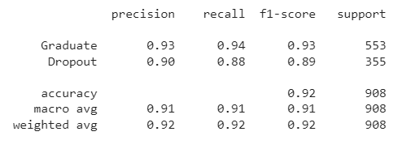



Retrain the model → RandomOverSampler Module (from Imbalanced Library)
WHEN USING THE OVERSAMPLED DATA OF THE DROPOUTS
OVERALL ACCURACY REMAINED SAME (92%)
DROPOUT RECALLINCREASED FROM 86% TO 88%
Notes:
Therefore we used the RandomOverSampler Module from the Imbalanced Library to Retrain the Model.

Slide 16

Can we improve the model further?

Slide 17
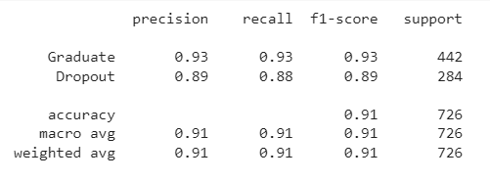
Adjust test/train split - Retrain model
-train/test split of 80/20
-Dropout recall (91% from 92%)
-Accuracy same (88%)

Slide 18
Can we improve the model further?

Slide 19
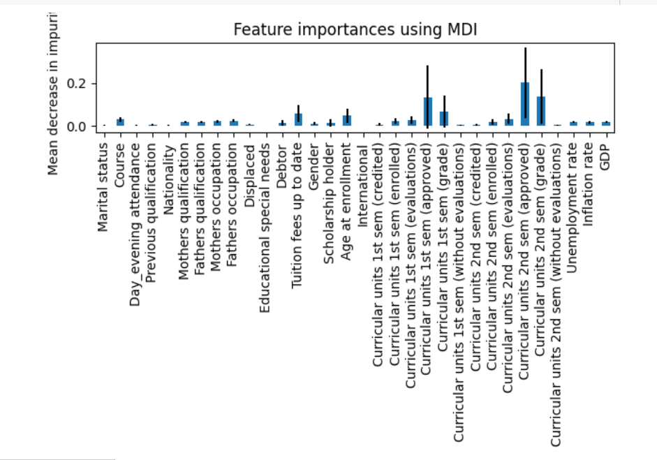
Can we identify features of importance?
-RandomForest
-baseline 32 features of importance

Slide 20
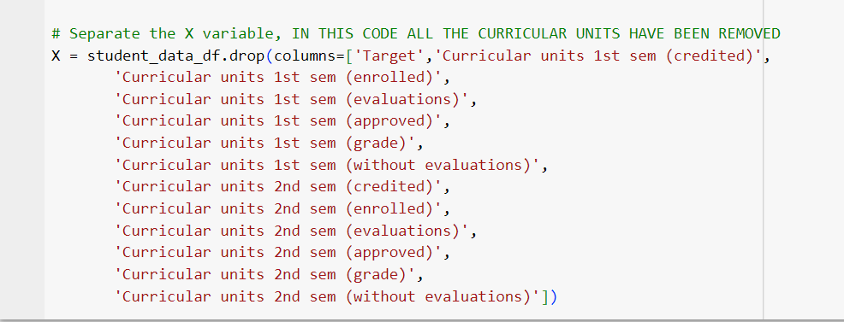
What features are we aware of before the student has started the course?
Let’s see what effect removing all the curricular unit features has on the model

Slide 21
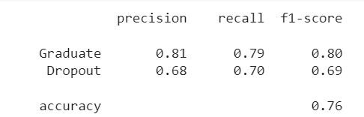
Removing curricular data features → worsened model accuracy (76% from 92%)
Notes:
So although that hasn’t worked, it has given us useful information which is quite intuitive, if you are struggling in semester 1 and 2.

Slide 22
Can we improve the model further?

Slide 23
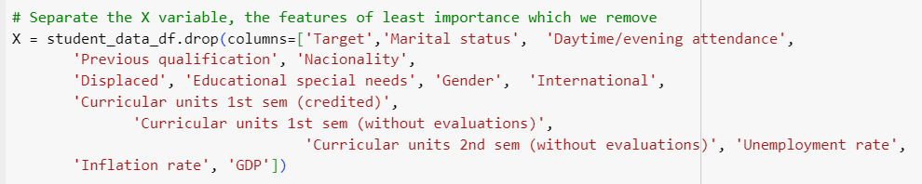
Remove all the features of least importance

Slide 24
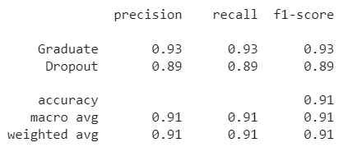
Removing Features:
Accuracy: Not improved, BUT similar to previous best

Slide 25
Can we improve the model further?

Slide 26
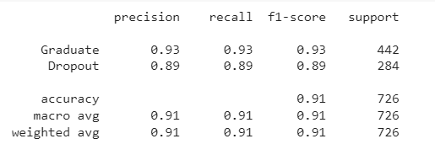
Scaling all the data
Retrain the model: Accuracy didn’t improve (91% vs previous best of 92%)

Slide 27
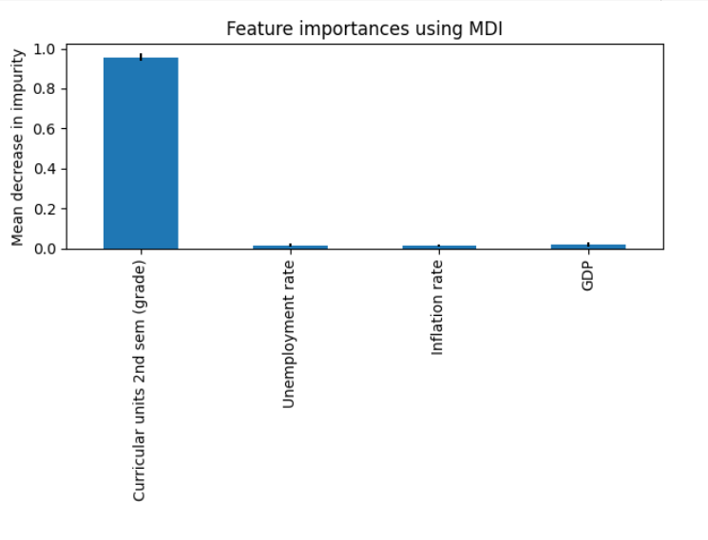
Scaling selected data

Slide 28
Can we improve the model further?

Slide 29
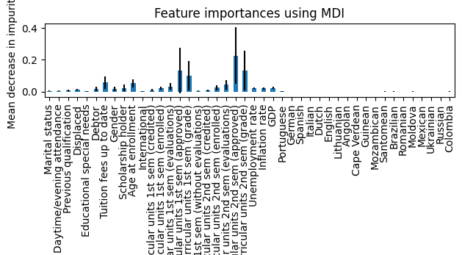
One-Hot Encoding
Notes:
we One-Hot Encoded different features. For example here we hot encoded the nationality of the students. The sample was quite small, but you can see that there is an association with the accuracy of the model if you are from poorer countries eg Santomena (Sao Tome and Principe a former Portugese colony in the Caribeean), Brazil, Moldova and Columbia .

Slide 30
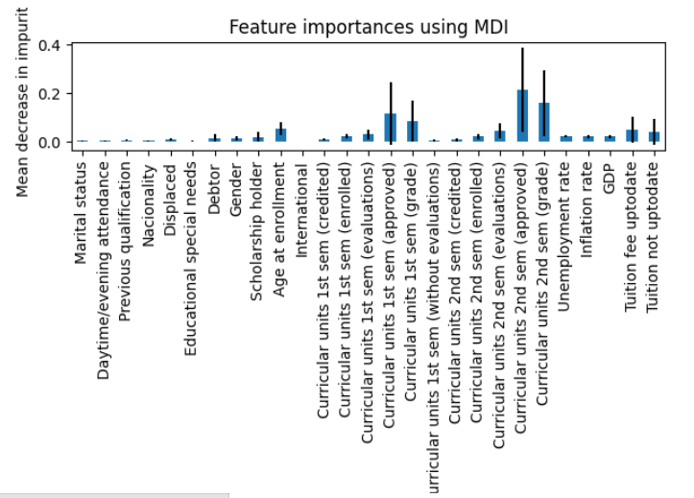
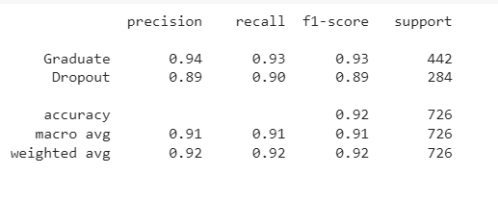
One Hot Encoding: tuition fee status
Tuition fee ‘being upto date’ was a more important feature in contributing to the model but model accuracy remained the same

Slide 31
Conclusion
Exploratory analysis: Identified features strongly related to Dropouts:
Younger students at enrollment
Certain degrees courses (Biofuel production, Informatics Engineering)
International students status.
Accurate Supervised Learning Model created to predict Graduate/Dropout status.
Notes:
Finally we created an accurate supervised learning model by modifying a number of status.

Slide 32

Questions?

